Slide 1
2025-12-02
PR survey
Agria Pet Insurance
Norway

Slide 2
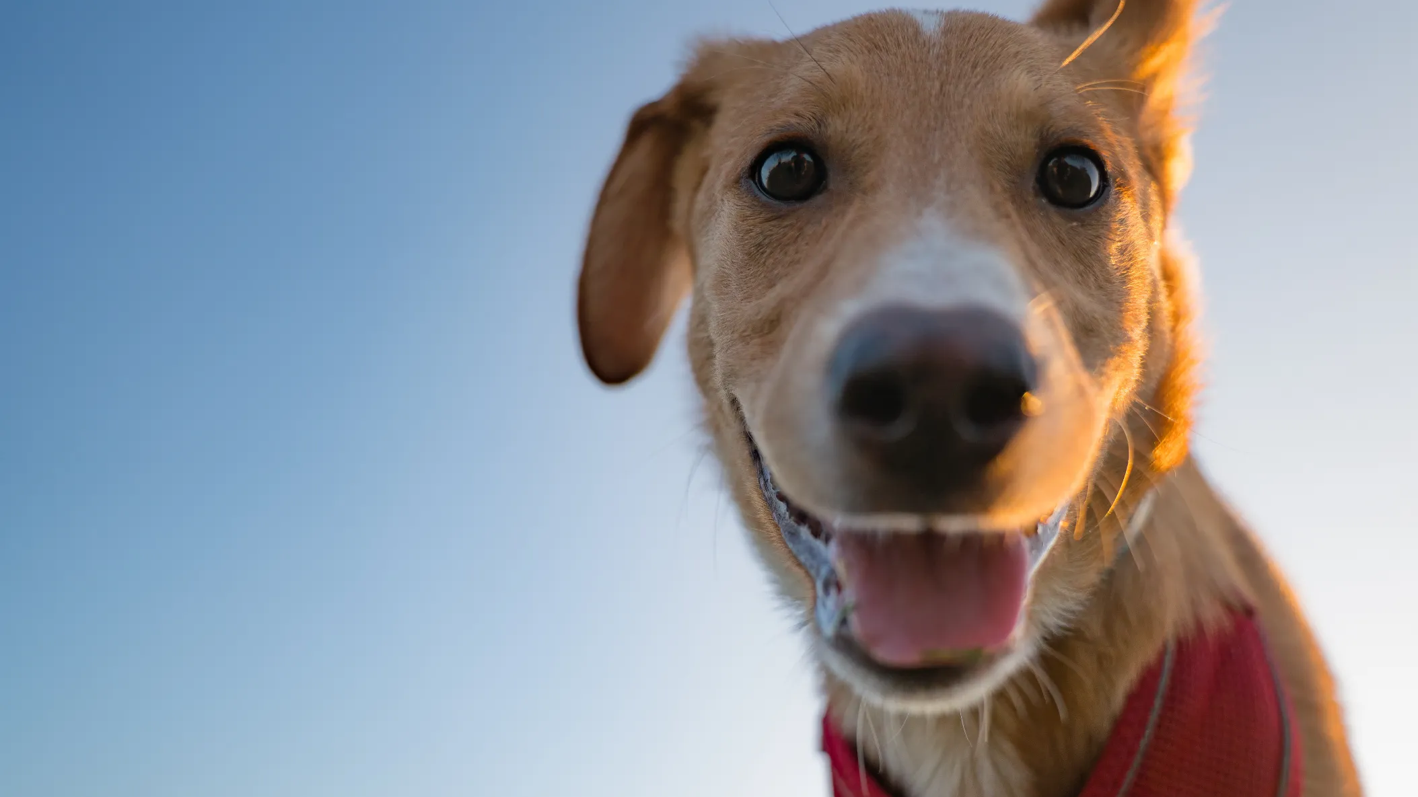

Timing & Method
Number of interviews (base)
406 interviews with dog owners
405 interviews with cat owners
between 18-74 yrs in Norway
Method
Web interviews using online panels.
When?
Interviews were conducted in November 2025.

Slide 3
How much do you appreciate your vet?
Dog- and/or cat owners
Pet owners have a high appreciation for their vet, dog owners a bit more than cat owners as well for women and younger pet owners.
Owns either a dog or a cat
Hvor mye setter du pris på veterinæren din?
Base: Dog- and/or cat owners.

Slide 4
Jonas Magnusson
jonas@xtreme.se
Xtreme Insight AB
Sankt Eriksgatan 48 G
112 34 Stockholm
www.xtreme.se
Josefine Bratt
Josefine.bratt@xtreme.se
Xtreme Insight AB
Sankt Eriksgatan 48 G
112 34 Stockholm
www.xtreme.se

